Slide 1

Capstone Project “Loan Performance”
Analytics and Visualization
By
Madhu Samudrala

Slide 2
About Lending Club
Lending Club is a US peer-to-peer lending company, headquartered in San Francisco, California, has been operating for the past nine years.
Lending Club conducts its operations completely online without any branch infrastructure. The no branch model helps in saving costs which is passed on to borrowers as lower interest when compared to other conventional lending agencies.
They provide personal loans, business loans and loans for elective medical procedures. Borrowers access loans at a lower interest rates and investors pool in money to earn interest.
Lending Club makes several datasets available on their website. It's a real world data set with a nice mix of categorical and continuous variables.

Slide 3
Problem Statement & Solution
The main challenge faced by most financial institutions is determining probability of default.
If a lender could forecast how many loans would be paid by the term, how many would become delinquent and how many loans would be re-structured, it would help the lender plan investment sources better, manage cash flows efficiently.
This would also save a lot of cost on unnecessary administrative and legal procedures and collection efforts.
This model is aimed to calculate probability of default, considering certain key data point to ease the problem described above.

Slide 4
About the Dataset
I have used the 2007 to 2011 file available on the Lending Club website.
URL -> https://www.lendingclub.com/info/statistics.action
Rationale for selected years: Aim to analyze loans with reasonable level of maturity which have an established pattern and a predictable outcome.
A total of 42,535 records are available for the 4 year period.
Fields and description of the fields of the dataset:

Slide 5
Analysis and Prediction
Analysis:
Loan Performance Details
Total Loan Issuance by period, region and loan type
Return on investment (interest earned)
Loan default
Grade Mix Over Time
*Above analysis is depicted in Tableau along with the predictive model. The dashboard is available in the below url
https://public.tableau.com/views/LoanPerformance/LendingClubStatistics?:embed=y&:display_count=yes&:showTabs=y
Prediction: Build a model to predict probability of default for loans. The live app would accept inputs of the applicant and return a probability of the applicant becoming delinquent.

Slide 6
Prediction Summary Approach
Read and Clean the Data – Get rid of annoying column, NULL, N/A, etc.
Classify bad indicators – From the status column identify good and bad repayment behaviour
split the data into training (75%) and test (25%) sets
use R's Random Forest package to predict probability default
Deploy to Shiny app

Slide 7
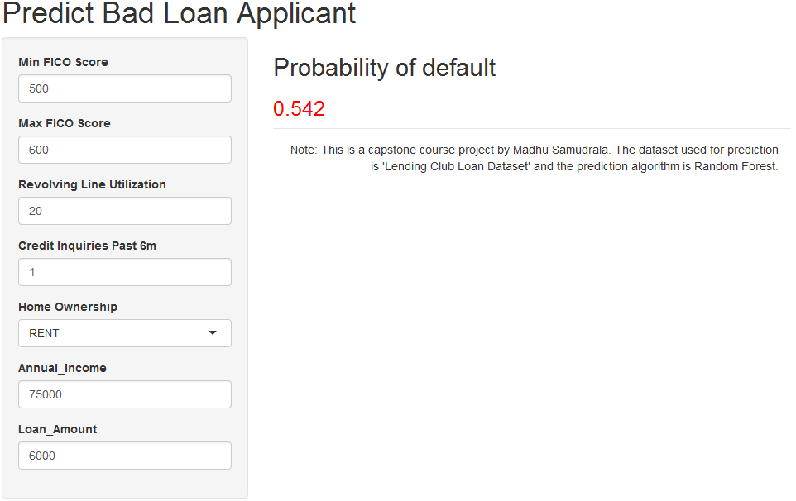
Prediction Model
URL: https://madhusamudrala.shinyapps.io/loan/

Slide 8
Thank You

